Slide 1
Capstone Design Team F
진행 상황
2016310237 김동우
2016314577 김동한
2016311033 김영현
2017312329 최형규

Slide 2
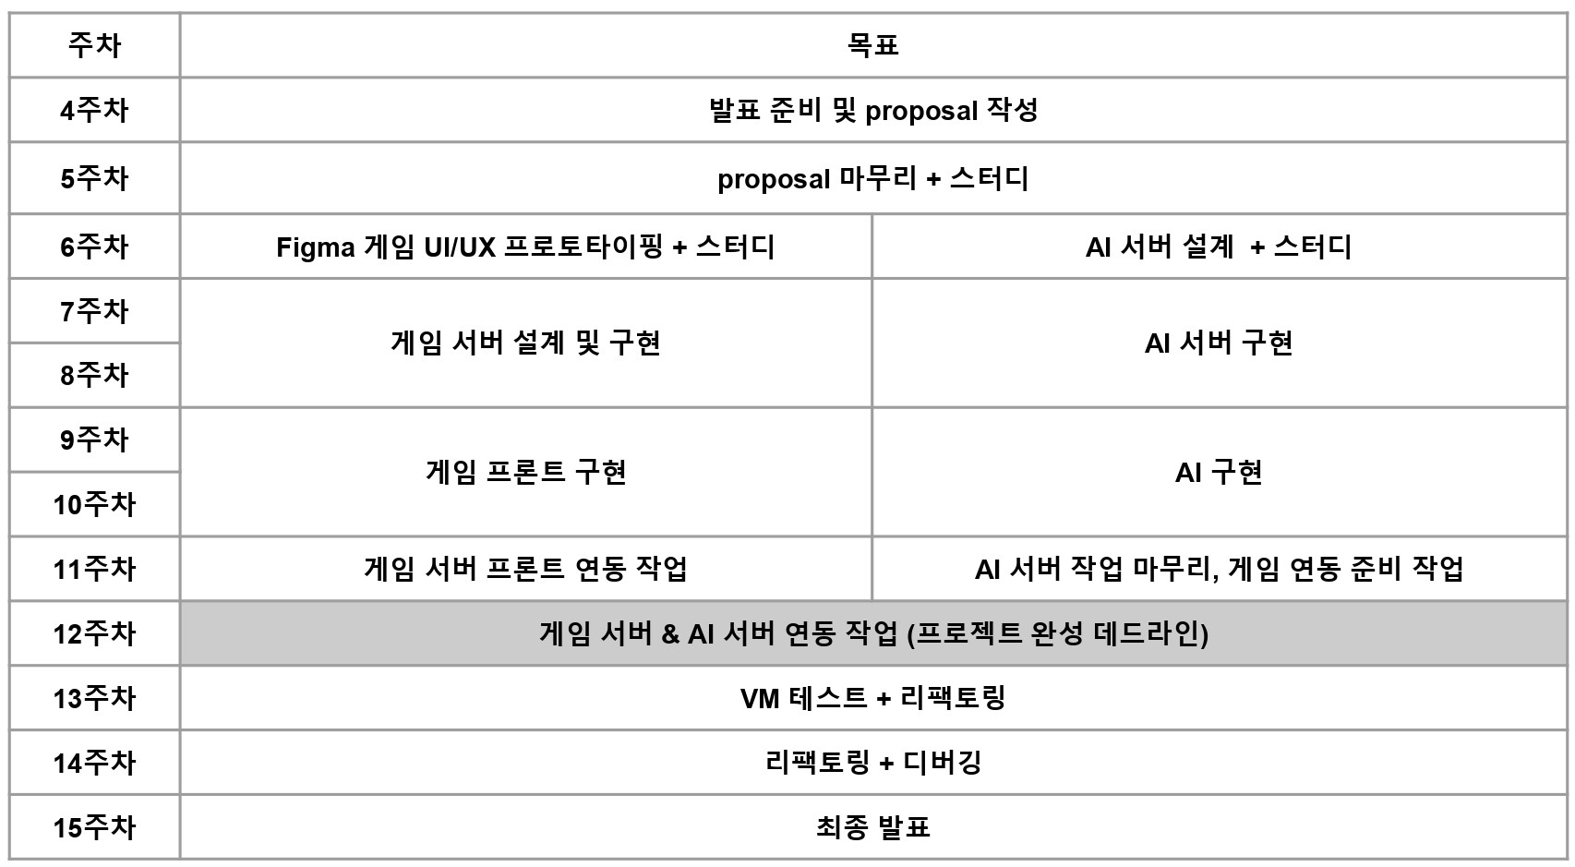
Weekly Plan

Slide 3
진행 상황 - Game
User logout
Chating
Make canvas
(html5 canvas)

Slide 4
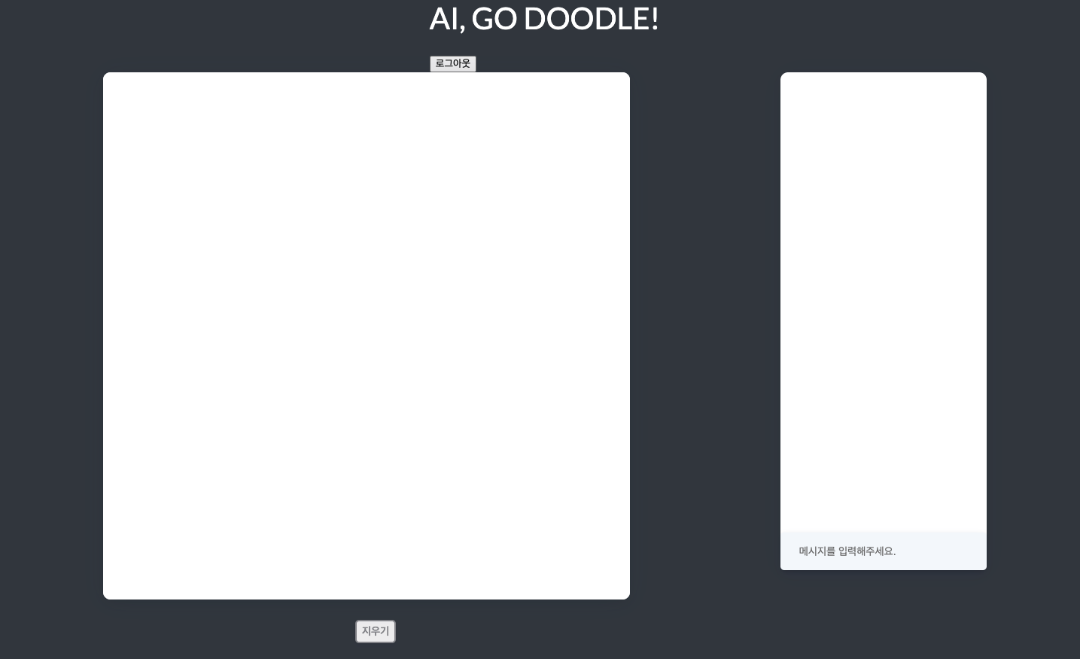
진행 상황 - Game

Slide 5
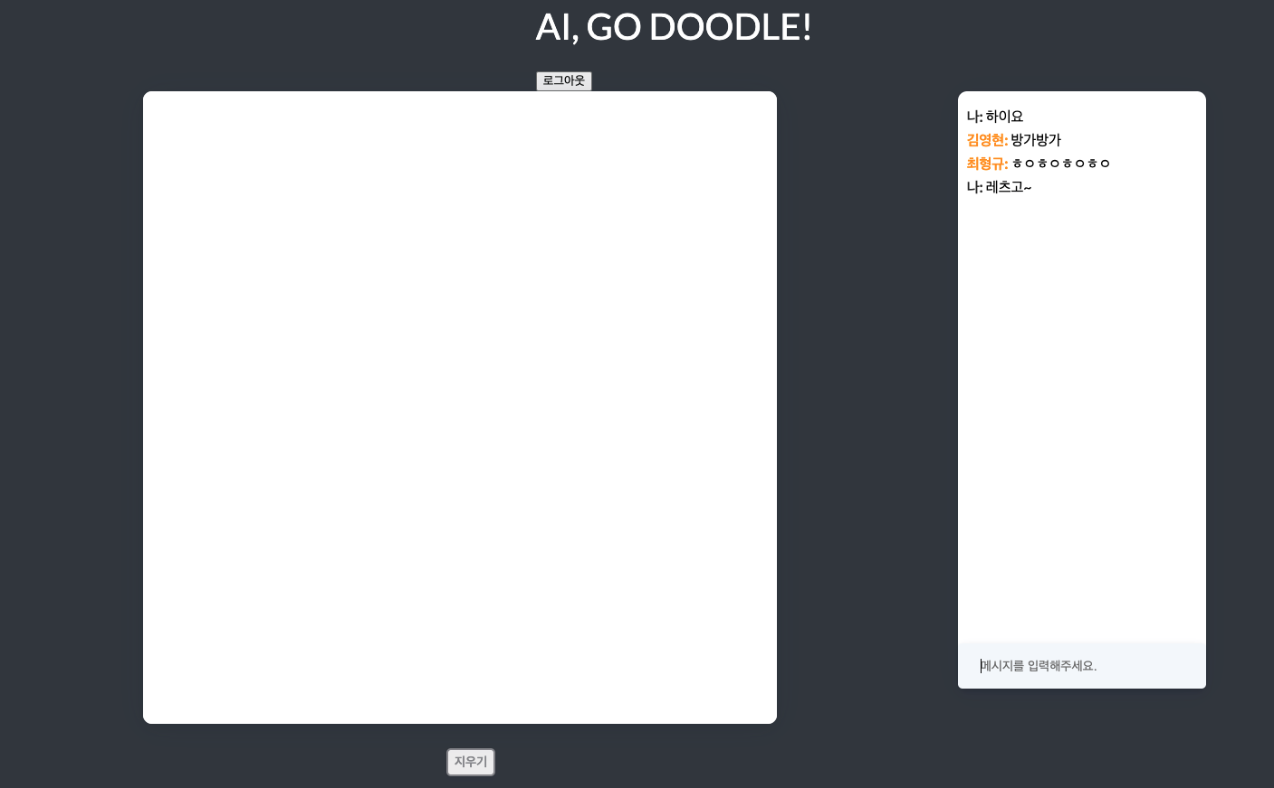
진행 상황 - Game

Slide 6
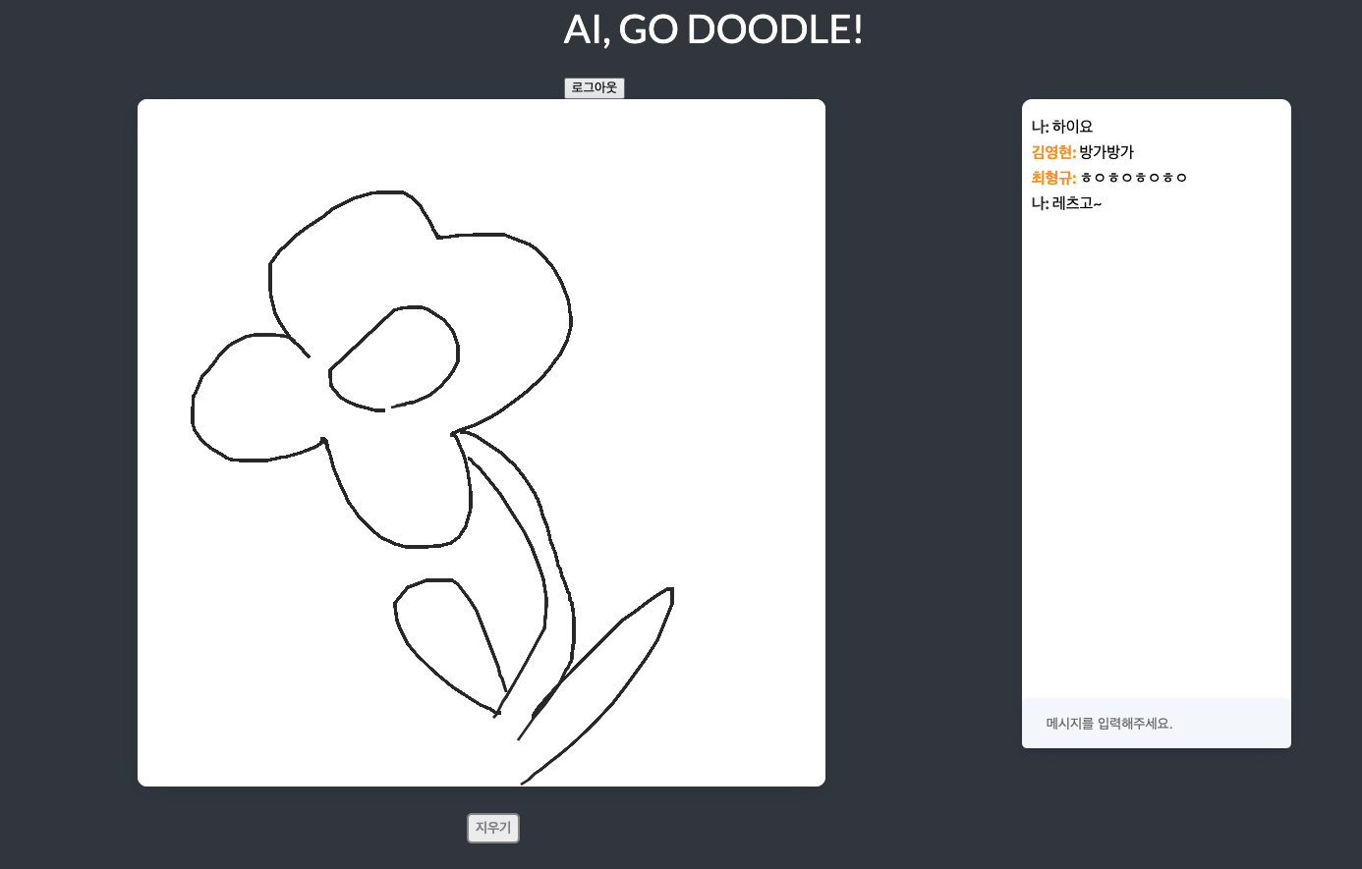
진행 상황 - Game

Slide 7

진행 상황 - Game & Chat Flow

Slide 8
TODO - Game
Game
New user : 최형규
UI styling
Timer (30s)
Suggested word
Send canvas to Server(A.I)

Slide 9
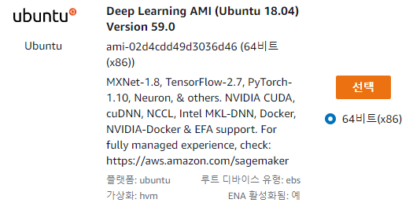

진행 상황 - A.I Server

Slide 10
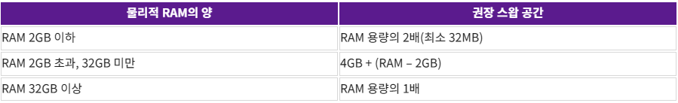
진행 상황 - A.I Server

Slide 11
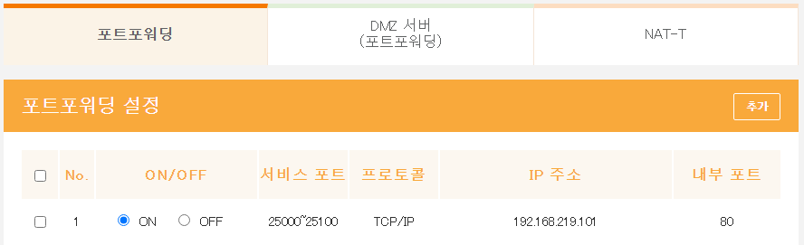
진행 상황 - A.I Server

Slide 12
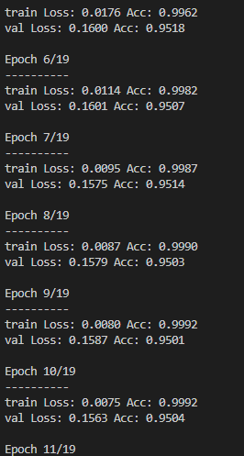
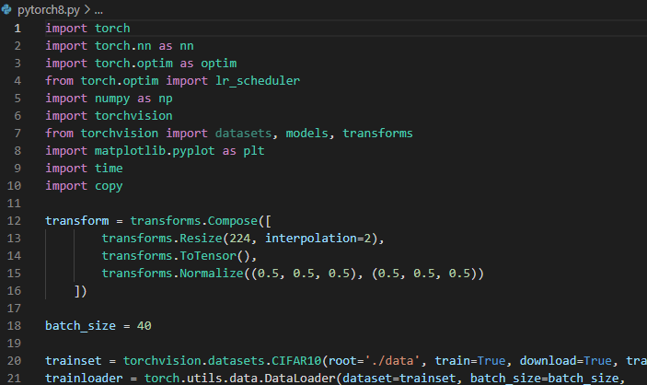
진행 상황 - A.I Server
ResNet18

Slide 13


Training Strategy
Quick draw dataset)
preprocessing
<m x n image>
<28 x 28 image>

Slide 14


Training Strategy
Previous approach)
Deep Learning Models
<28 x 28 image>
<224 x 224 image>
Current approach)
Deep Learning Models
zero-padding
<28 x 28 image>
<32 x 32 image>

Slide 15
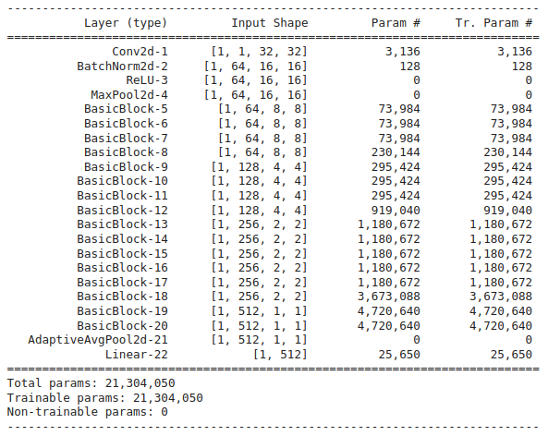
Resnet34
- models for Imagenet => at least 32 x 32

Slide 16
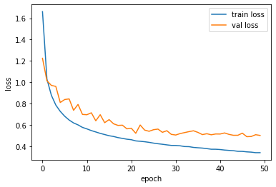
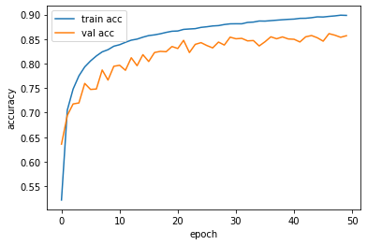
Resnet34
- class 30
- images per class 5000
- accuracy : 88.4%

Slide 17
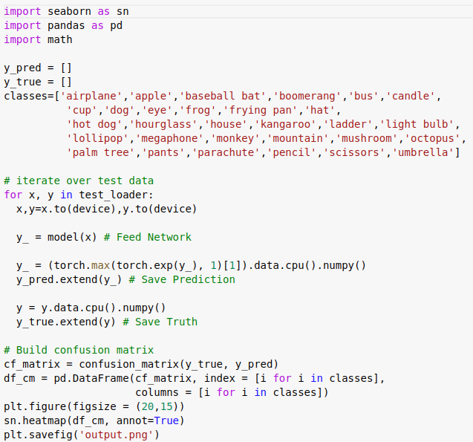
Resnet34-confusion matrix

Slide 18
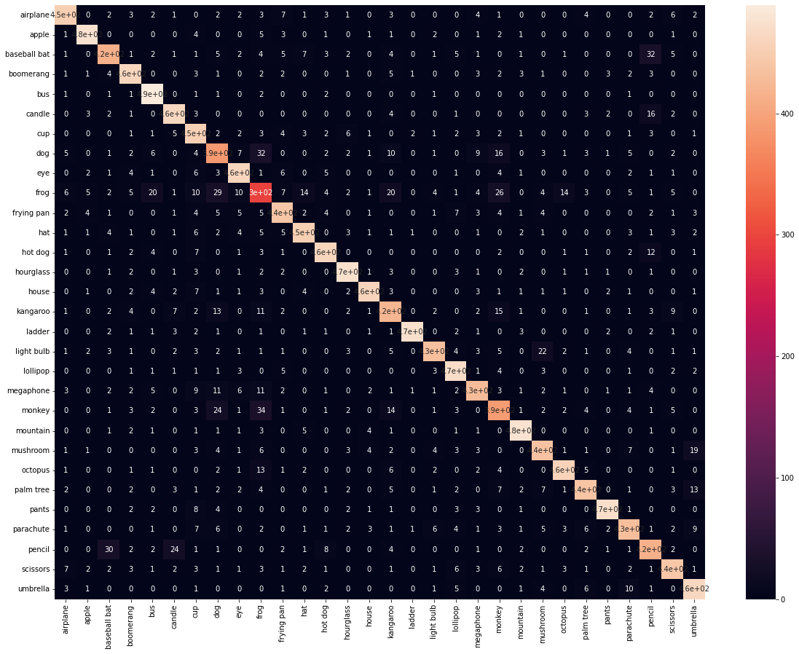
Resnet34 - confusion matrix
- confusion between animals
kangaroo & dog
kangaroo & frog
dog & fog
monkey & kangaroo
so on…
- confusion between shapes
candle & pencil
pencil & baseball bat
best) avoid animals…

Slide 19
Applying model
ideal)
model trained with 100 classes
prediction
user drawing
(mountain)

Slide 20
Applying model
model trained with 25 classes
model trained with 25 classes
prediction
model trained with 25 classes
user drawing
(mountain)
model trained with 25 classes

Slide 21
AI part TO-DO
A.I
code refactoring
test with MobileNet
finalize experiment and select model
parallel training of models for different classes

Slide 22
Thank you

